Slide 1
Ocean Predictions and uncertainty estimates Nadia Pinardi University of Bologna and Istituto Nazionale di Geofisica e Vulcanologia
SUMMARY
The prediction/forecasting problem concepts and historical notes
Ocean forecasting at work: the Mediterranean Sea
The uncertainty in winds projects on the ocean mesoscales

Slide 2

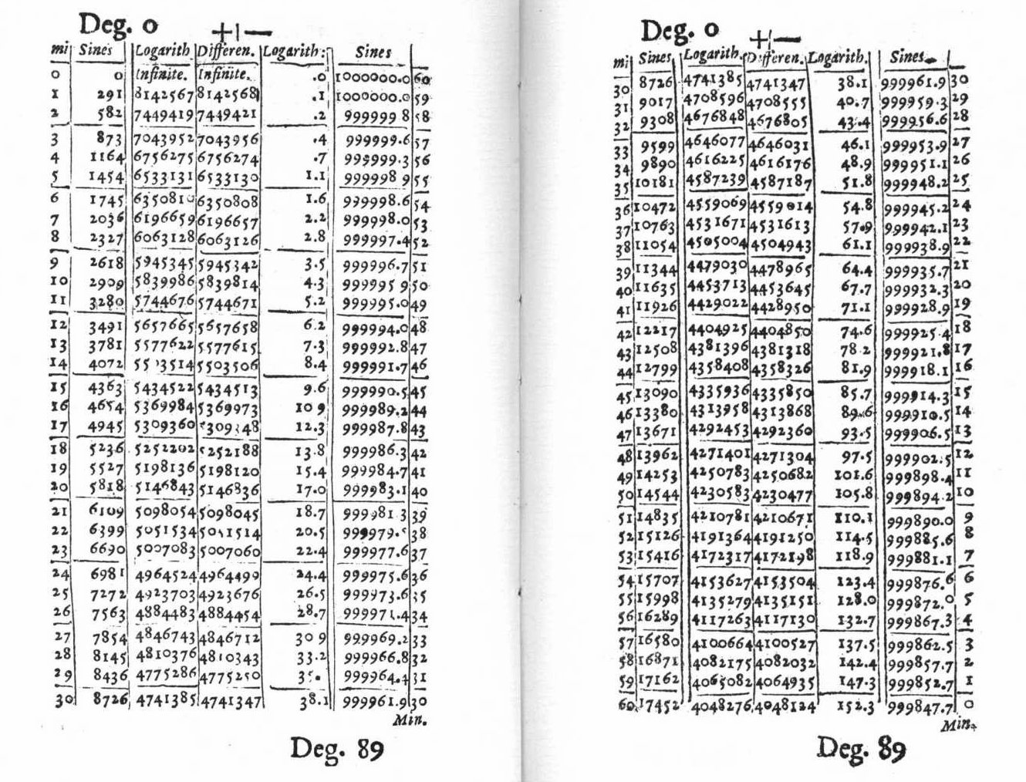
What is it that I really seek? Whither am I steering?
I could not free myself from the thought
that “There is after all but one problem worth attacking,
viz, the precalculation of future conditions.”
V. Bjerknes, ‘Meteorology as an exact science’,
Monthly Weather Review, 1914
Napier, 1614, Mirifici logarithmorum canonis descriptio

Slide 3
The forecasting/prediction problem definition 1/2
Bjerknes (1904, 1914) defined for the first time the ‘rational method for weather predictions’
In opposition to purely empirical and statistical methods, Bjerknes presented his rational version of forecasting based on the laws of mechanics and physics of the atmosphere
Bjerknes developed a method to “construct the pictures of the future states of the atmosphere from the current state of the atmosphere at a starting point” following the deterministic approach set by Pierre de Laplace in 1820: ”We ought to regard the present state of the universe as the effect of its antecedent state and as the cause of the state that is to follow”

Slide 4
The prediction problem definition 2/2
Two conditions should be fulfilled in order to solve the prediction problem in atmosphere and oceans
I- Know the present state of the system as accurately as possible
II- Know the laws of physics that regulate the time evolution of the basic field state variables, i.e. have predictive models for atmosphere and oceans
In order to solve the prediction problem the scientific approach should consider 3 partial problems
Comp.1: The observational network
Comp.2: The diagnostic and analysis tools/algorithms
Comp.3: The prognostic component

Slide 5
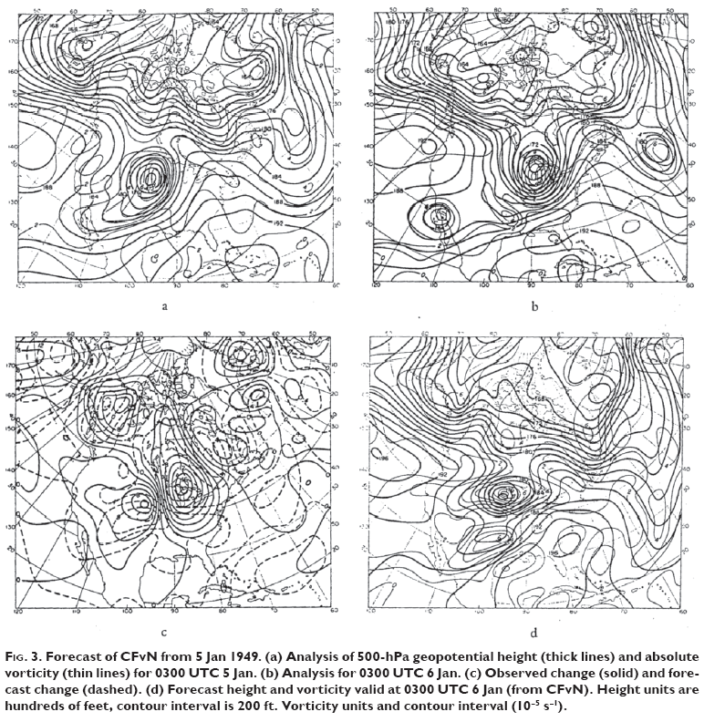
The first successful forecast: Princeton 1950
Analysis
of 850 hPa
Geo. Height
03:00 UTC
Jan 5, 1949
Analysis
of 850 hPa
Geo. Height
03:00 UTC
Jan 6, 1949
The key choice:
barotropic quasigestrophic numerical model
Forecast
of 850 hPa
Geo. Height
03:00 UTC
Jan 6, 1949

Slide 6
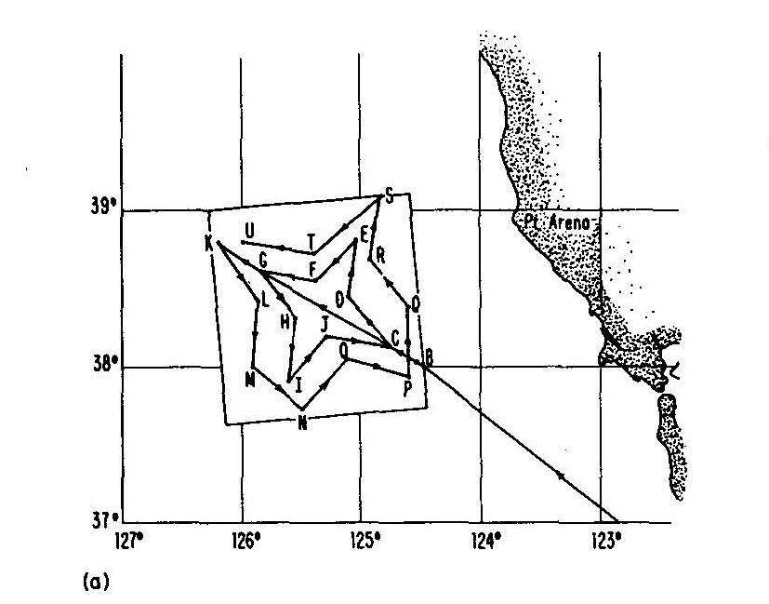
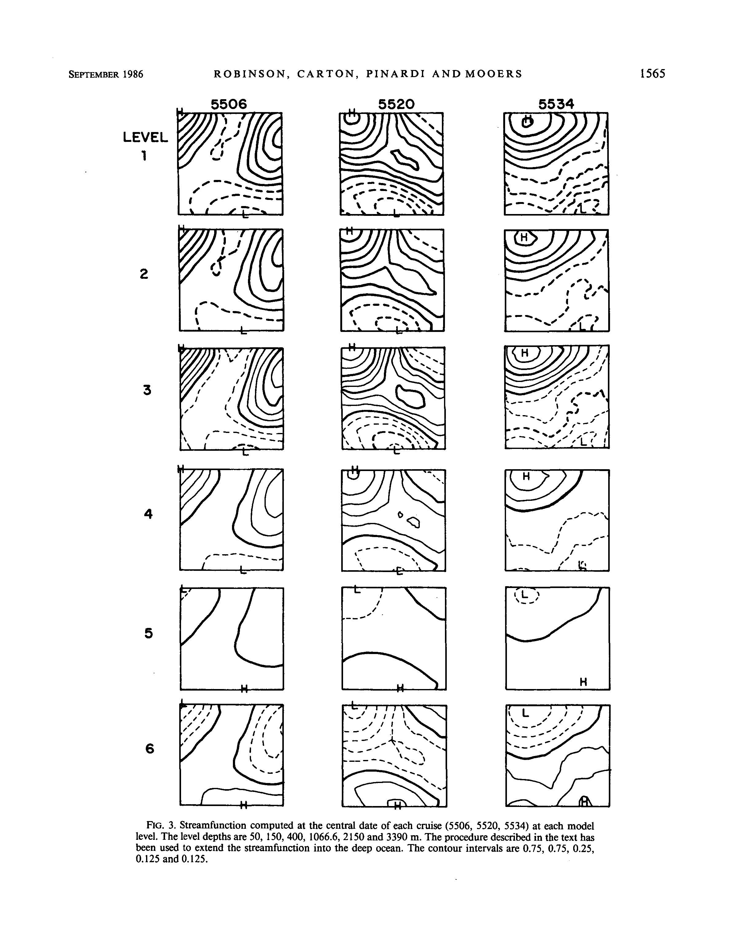
The first ocean forecast: Harvard and Monterey 1983
The key choice:
synoptic data
for initial conditions
baroclinic
multilevel
Quasigeostrophic
model
1983,
Cruise track
California
T=
T=
T=

Slide 7
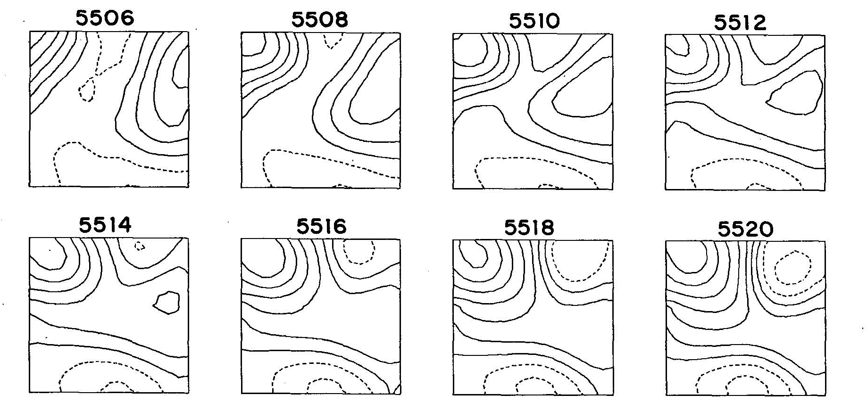
The first ocean forecast: Harvard and Monterey 1983
Initial condition
Final forecast
validation

Slide 8
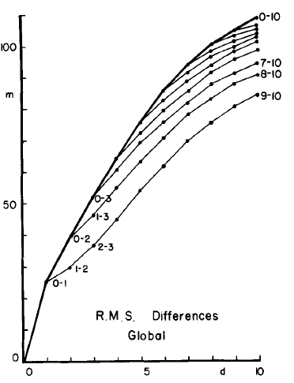
In the 60-80’s Lorenz set the theoretical basis for the definition of the predictability problem
Lorenz (1969) defined the atmospheric predictability problem as: the time for which two analogue atmospheric states will double the initial difference among themselves.
Lorenz, 1982: used ECMWF forecasts
to evaluate predictability time
in a robust way
RMS differences of 500 mb height
Doubling time of forecast error
~ 3 days
Forecast days

Slide 9
Ocean predictions : the operational start
1992-2000:
Satellite altimetry started to give 10 days repeated mapping of the sea level with errors < 5 cm
The ship of opportunity profiles became available in near real time,
SST from satellite with accuracy > 0.5 deg C
Numerical large scale models started to resolve mesoscales and became more skillful to reproduce ocean processes
Atmospheric forcing became available at 50 km resolution
Data assimilation schemes started to be developed to assimilate both in situ and satellite sea level
At the same time, in the Mediterranean a program of ocean predictions started to organize Bjerknes three components at the basin scales
2003: ARGO program started also in the Med

Slide 10
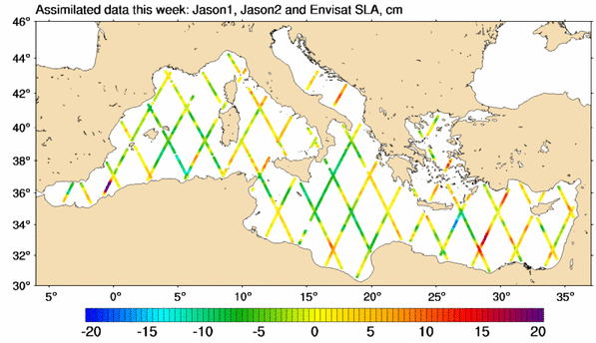
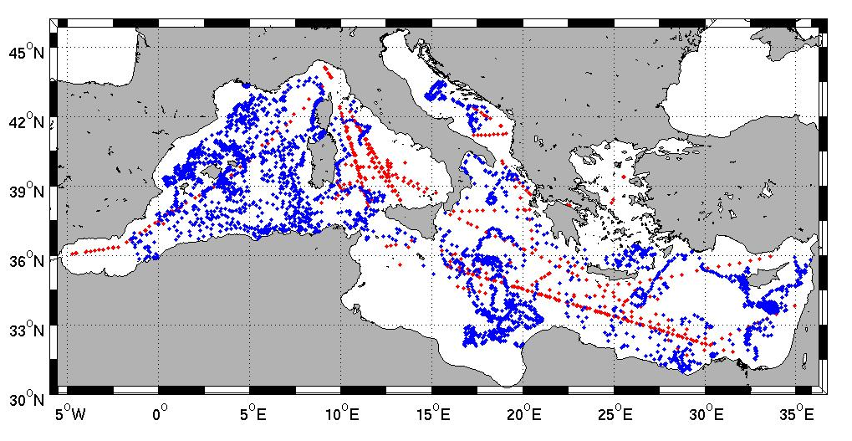
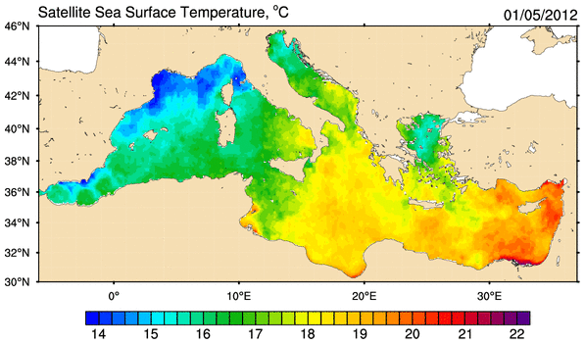
The near real time observing system components
Multisatellite along track sea level
coverage for the
2008-2011 period
Multi-sensor daily OI SST
SOOP
ARGO

Slide 11
The diagnostic component today
Method is variational, so-called 3DVAR
(Dobricic and Pinardi, 2008)
A cost function, linearized around the background state,
is minimized:
Preconditioning is done using a control vector v defined by:
is modelled as a sequence of linear operators:
- Vertical EOFs.
Diagnose u and v.
- Horizontal covariances.
Divergence damping
filter.
- Barotropic model for eta
11

Slide 12
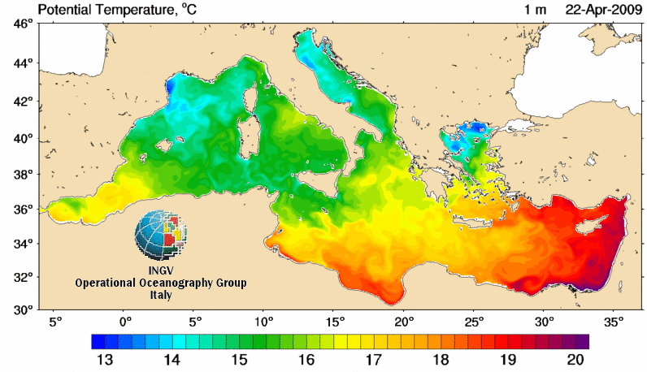
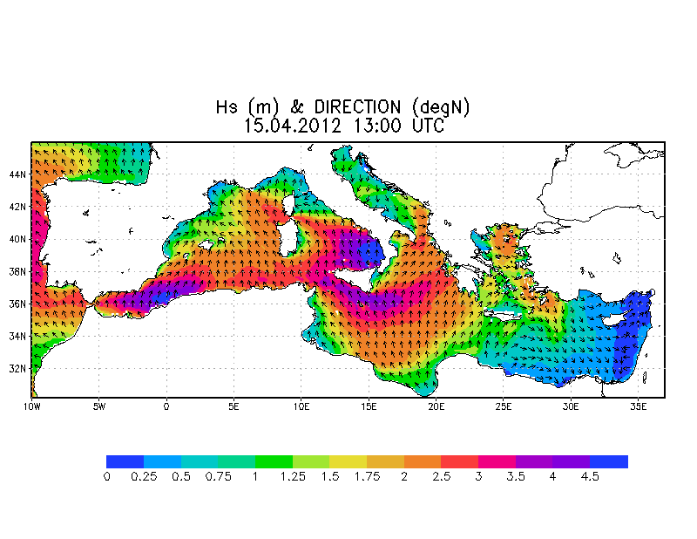
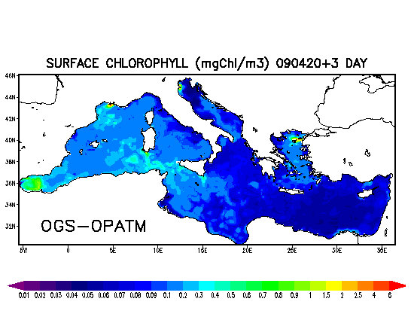
The ocean numerical prediction models
Hydrodynamics
(MFS)
1/16 deg resolution,
72 levels
B) Waves
1/16 degree resolution
Wind drag coefficient for hydrodynamics
C) Pelagic Biochemistry
1/16 deg resolution

Slide 13
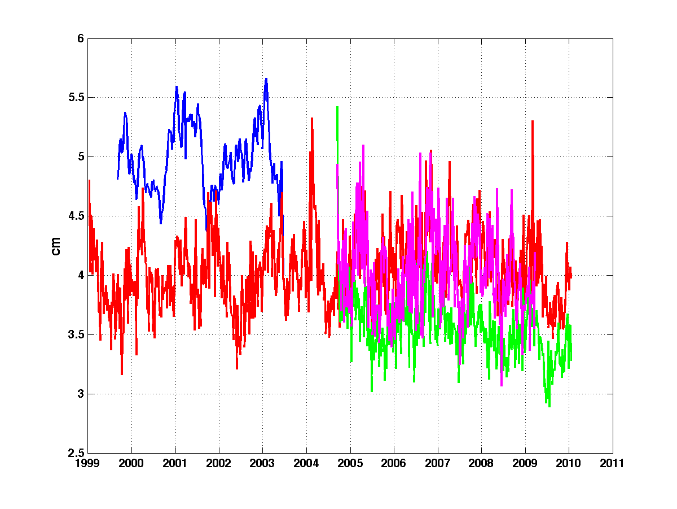
How did the error decrease in
the last 10 years?
SEA LEVEL in the Mediterranean
MOM1.1 +SOFA
OPA8.2 +SOFA (sys2b)
OPA8.2 +3DVAR (sys3a2)
NEMO+3DVAR (sys4a)
1999
rmse
2009
30% error
decrease
Model improvement is the major cause for error reduction

Slide 14
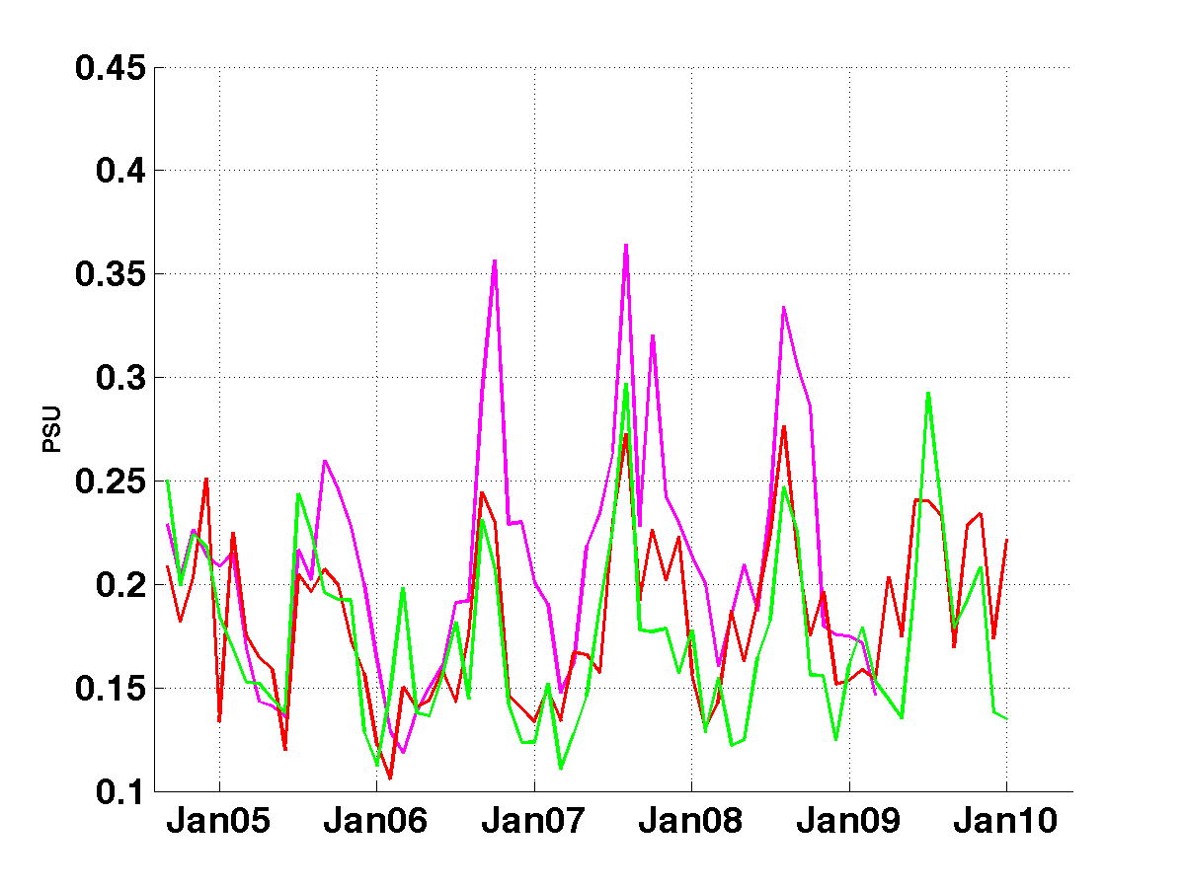
How did the error decrease in
the last 10 years?
30 m SALINITY in the Mediterranean
OPA8.2 +SOFA (sys2b)
OPA8.2 +3DVAR (sys3a2)
NEMO+3DVAR (sys4a)
20% error
decrease

Slide 15
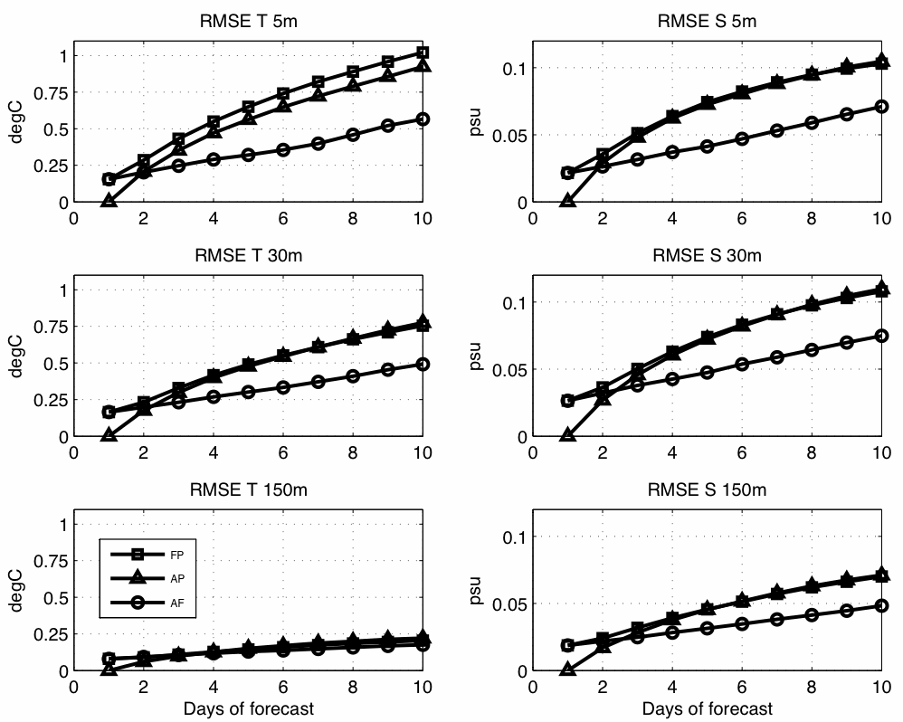
Predictability time for T and S
Analysis-forecast
Analysis-Persistence
Doubling of initial error is 6-8 days
Forecast days

Slide 16
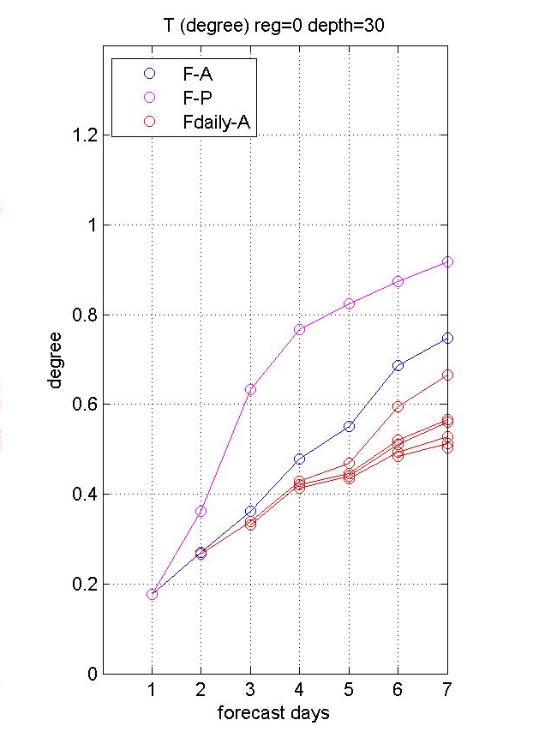
Forecast skill: the effect of atmospheric forcing errors
Control:
Forecast-persistence
Weekly forecast
Forecast error
at day 7
decreased by
30% only
reducing atmospheric
forcing error
Daily forecasts started from
simulations driven by atmospheric analyses

Slide 17
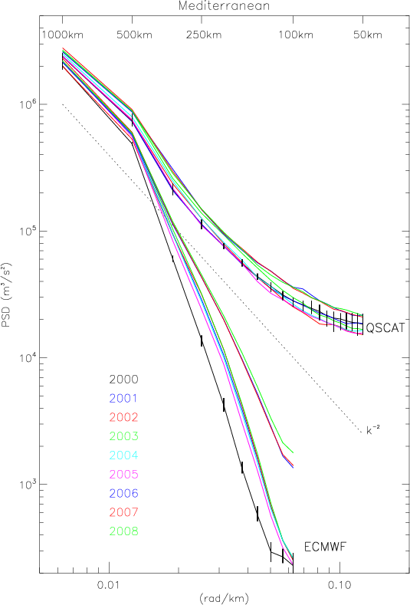
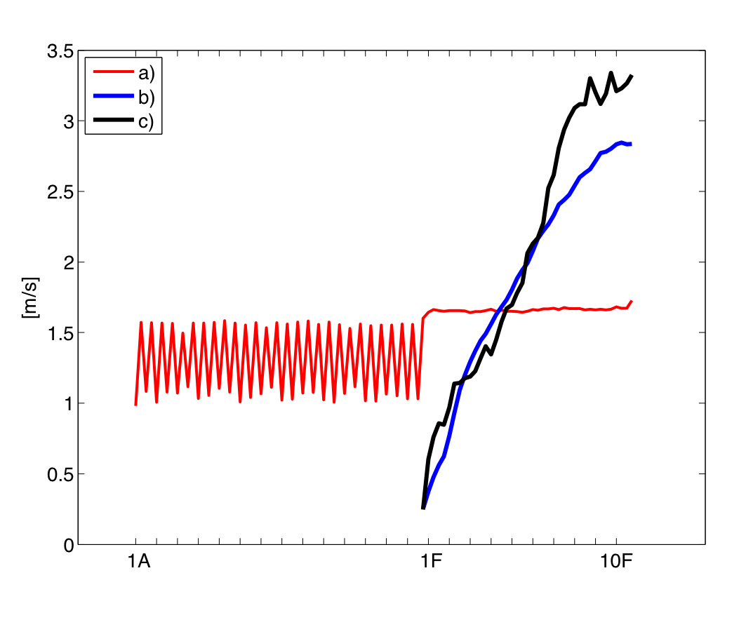
What is the uncertainty in the winds ? (Milliff et al., 2011)
Space scale
Horizontal scale
Of uncertainty
Forecast
Winds
(Black: ECMWF
deterministic
Blue: ECMWF
ensemble
2000
2001
2002
2003
2004
2005
2006
2007
2008
QSCAT
data
Wind amplitude
Kinetic Energy
2.5 days
error doubling time
ECMWF analyses
Forecast day

Slide 18
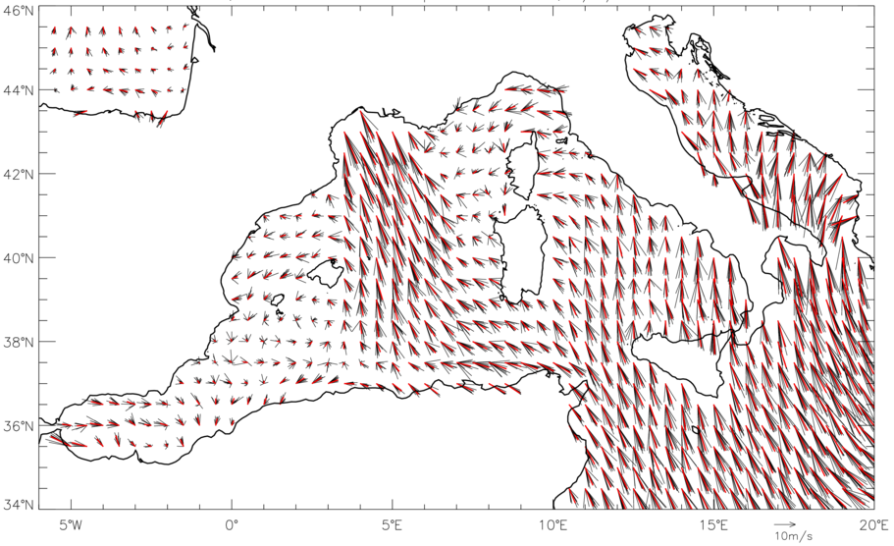
Posterior distributions of winds from a Bayesian Hierarchical Model: BHM-SVW realizations (Milliff et al., 2011)
10 realizations for February, 2 2005 at 18:00

Slide 19
The BHM-SVW Ocean Ensemble Forecast method (Pinardi et al., 2011)
Tuesday
Tuesday
Tuesday
Days
Ensemble
members:
10 sets of
analyses
and forecasts
forced
by BHM-SVW
realizations
.
.
.
Each ensemble member run
assimilates data and the winds
transit smoothly from analysis
to forecast
.
.
10 days Forecast
Analysis

Slide 20
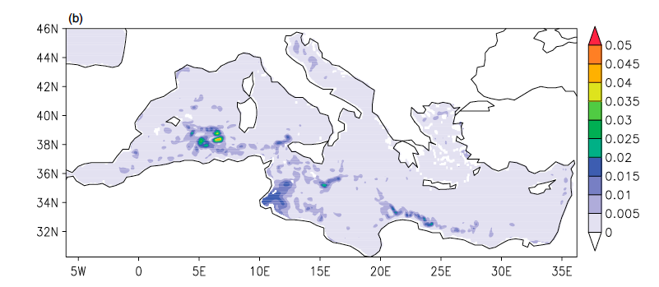
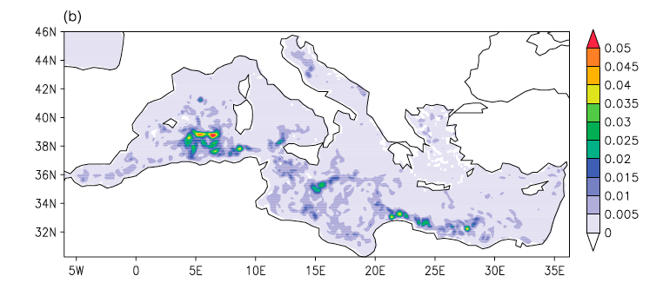
Uncertainty in the ocean predictions due to uncertainty in the winds
Initial condition spread: variance of sea level
10-th fcst day standard deviation
Uncertainty is concentrated at the mesoscales
Sea level std
is comparable
to observed sea level error

Slide 21
In conclusions
The Bjerknes method for atmospheric forecasting has been implemented operationally in the ocean in the past 15 years
For the Mediterranean Sea uncertainty (rms) is connected to, in order of priority:
Numerical ocean model improvements
Atmospheric forcing uncertainties, in particular winds
Predictability time scale for the ocean is 6-8 days
Atmospheric uncertainty drives ocean forecast uncertainty with values comparable to observational errors

